Slide 1
MULTYPHYSICS MODELING OF TRACER TRANSPORT IN SURFACE SUBSURFACE WATER SYSTEM
Krste Živković*, Hrvoje Gotovac, Marin Zelenika
Faculty of Civil Engineering, Acrhitecture and Geodesy, University of Split, Croatia.
* Presenting Author
COUPLED PROBLEMS 2021 THEMATIC CONFERENCE
14 –16 June 2021, Online Event

Slide 2
Content
Introduction
Problem formulation and methodology
- Mathematical model
- Numerical model
- Experimental model
Summary and Conclusions

Slide 3
Introduction
It is estimated that about 25% of the world’s population is supplied with domestic water from groundwater extracted from the karst (Chen at al.2017)
Karst aquifers are complex natural multiphysics system difficult for water supply, analysis and monitoring
Analysis of karst aquifers are faced by many difficulties including enough number of measurements, multiscale nature, different flow regimes and diversity
Transport karst modelling is very important due to protection of water resources and vulnerability of karst aquifers

Slide 4
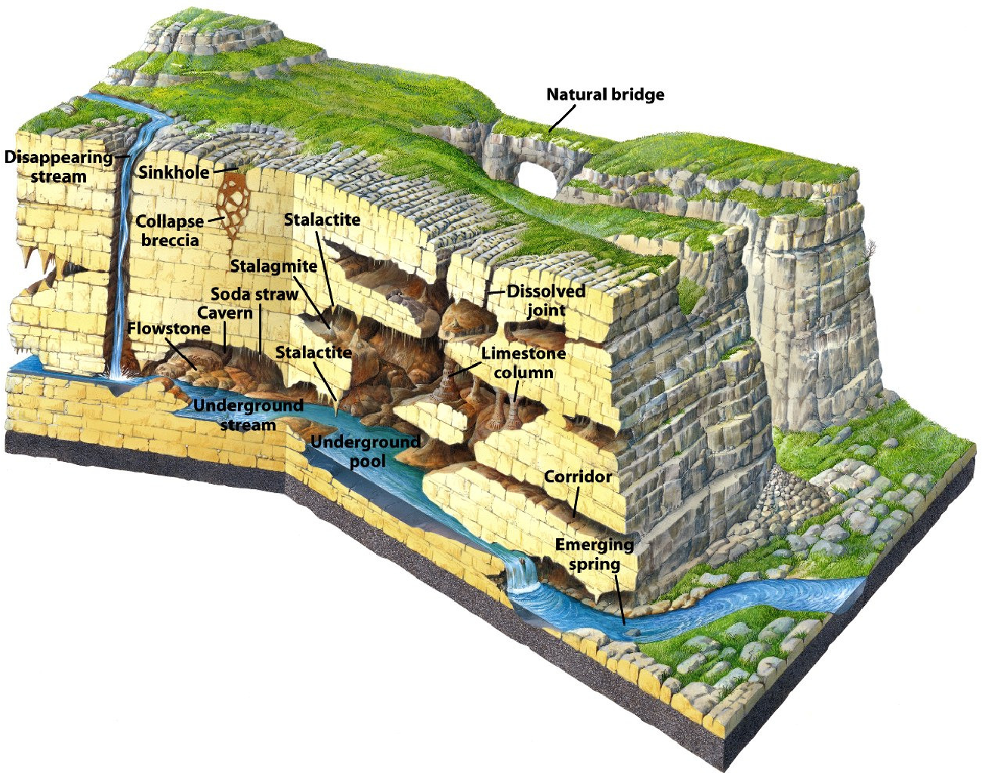
Karst aquifers are characterized by groundwater flow through intergranular porosity (primary or matrix porosity), fractures with slow laminar flow (secondary porosity) and conduits with rapid turbulent flow (tertiary porosity)
Figure 1: Karst Aquifer. This karst aquifer shows karst features such as dissolved sinkholes, caves, and fractures, through which water flows. Karst features such as caves and fractures can be partially submerged to fully submerged in water. Figure is from Marshak, 2008.

Slide 5
Main task of multiphysics in karst aquifers is to couple different flow regimes in different domains such as:
1. Surface flow
- runoff flow
- channels and river flow
2. Subsurface flow
- karst matrix flow
- deep karst conduit flow
- fracture flow

Slide 6
Problem formulation and methodology
Discrete-continuum (hybrid) approach is used to couple (Malenica et al., 2018):
3D subsurface matrix flow and transport
2D runoff surface flow and transport
1D flow and transport in chanels,rivers and conduits

Slide 7

Matematical modeling (flow)
Flow in the karst matrix is based on the governing equation for variably saturated subsurface flow in a porous medium – 3D Richards equation:
The one-dimensional flow in karst conduits and channels in the l-direction is given by -1D noninertia wave equation:
Exchange of Water Between the Matrix and conduit Flow
- H is the hydraulic (piezometric) head in Matrix (L),
- h is the hydraulic (piezometric) head in Conduits (L),
- α_{ex} exchange coefficient (T⁻¹),

Slide 8

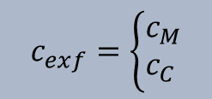
Mass transport in all domains are described by Advection-Dispersion Equation (Yeh et al., 2006)
Exchange flux between matrix and conduits:
$$J_{ex}=q_{ex}∙c_{exf}$$
- $I_{ex}−based on advective transport between matrix and conduit$
- $c_{M}−concetracion from matrix$
$$c_{exf}=\left\{\begin{aligned}&c_{M} \\ &c_{C}\end{aligned}\right.$$
- $c_{C}−concetracion from conduit$

Slide 9
Numerical modeling
Based on Control Volume Isogeometric Analysis; CV-IGA, see Malenica et al., 2018, Gotovac et al., 2021
IGA – general idea of the IGA approach is to use non-uniform rational B-splines (NURBS) that are used to represent the geometry in the CAD tool also as a basis for numerical analysis of the partial deferential equations (PDE) via FEA.
By seeting appopriate weighting function and applying divergence theorem you can apply IGA on CV

Slide 10
Figure 2: Schematic illustration of NURBS paraphernalia for a one-patch surface model. Open knotvectors and quadratic C1-continuous basis functions are used. Complex multi-patch geometries may be constructed by assembling control meshes as in standard finite element analysis. Also depicted are C1-quadratic (p = 2) basis functions determined by the knot vectors. Basis functions are multiplied by control points and summed to construct geometrical objects, in this case a surface in R3.

Slide 11
Experimental setup
To verified numerical model, two physical models are build in new laboratory in Žrnovnica near Split
First one is smaller basin
Overall dimension
5.66 m x 2.95 m x 2.00 m
(Malenica et al., 2018):
Figure 3: Photography of physical model.

Slide 12
-Two water reservoirs, are used to specify the water levels (boundary conditions)
- The model is filled by heterogeneous porous material, which is used to simulate the karst matrix.
-Three type of materials are used: coarse quartz sand ,fine quartz sand, and gravel
– The top 25 cm of the soil is filled by gravel to simulate epikarst effects.
- In the middle of the model, there is a zone of fine quartz sand, which is used to produce a pressure drop and to decrease the overall matrix velocities.
- Plastic perforated pipes are installed through the porous medium and are used to simulate karst conduits, whereas vertical branches are directly connected with conduits to simulate sinkholes.
-On the top of the concrete construction, there are sprinklers and shower heads for rainfall simulation.
-The flow (computational) domain of matrix excludes walls and reservoirs, and the dimensions are Lx = 4.0 m, Ly = 2.55 m, and Lz = 2.0 m.
- the pressure distribution is measured at 44 fixed points
Figure 4: Scheme of physical model

Slide 13
Results from experimental and numerical model for flow modeling
Figure 5: Hydrograph: comparison between experimental (dashed line) and numerical (solid line) results for matrix (M -blue line) and conduit discharge (C - red line)
Figure 6: Hydraulic head: comparison between experimental (dashed line) and numerical (solid line) results for two most dynamic piezometers that are closest to the conduits.

Slide 14
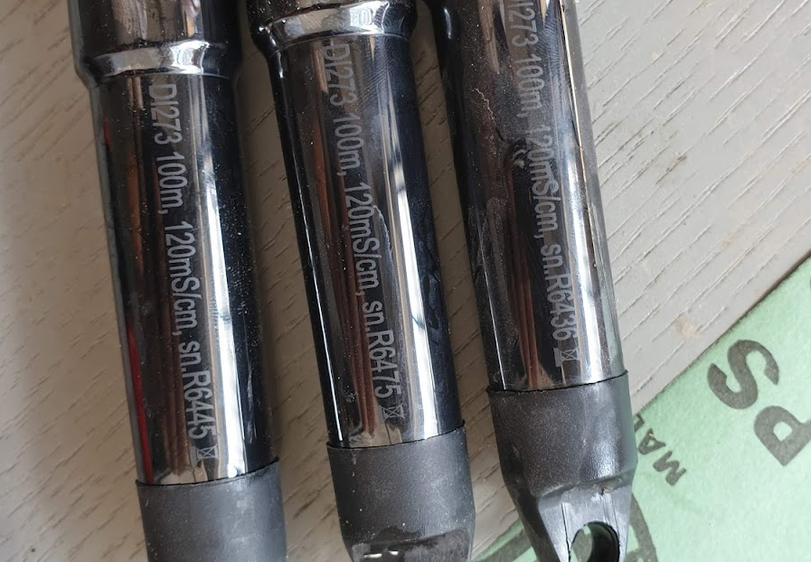
Tracer test
Tracer tests were performed by mixing a certain amount of salt with water in a 200 l container before starting the test. The liquid thus prepared is serve as a tracer in the test by measuring the electrical resistance in the pool with defined DIVER sensors at defined fixed points. The tests were performed with different gradients (different water heights in the water tanks), different amounts of salt in the previously prepared solution, and sensors were placed at key aquifer points to obtain the best possible data with a limited number of sensors.
Figure 7: CTD drivers used for measuring electrical resistance.

Slide 15
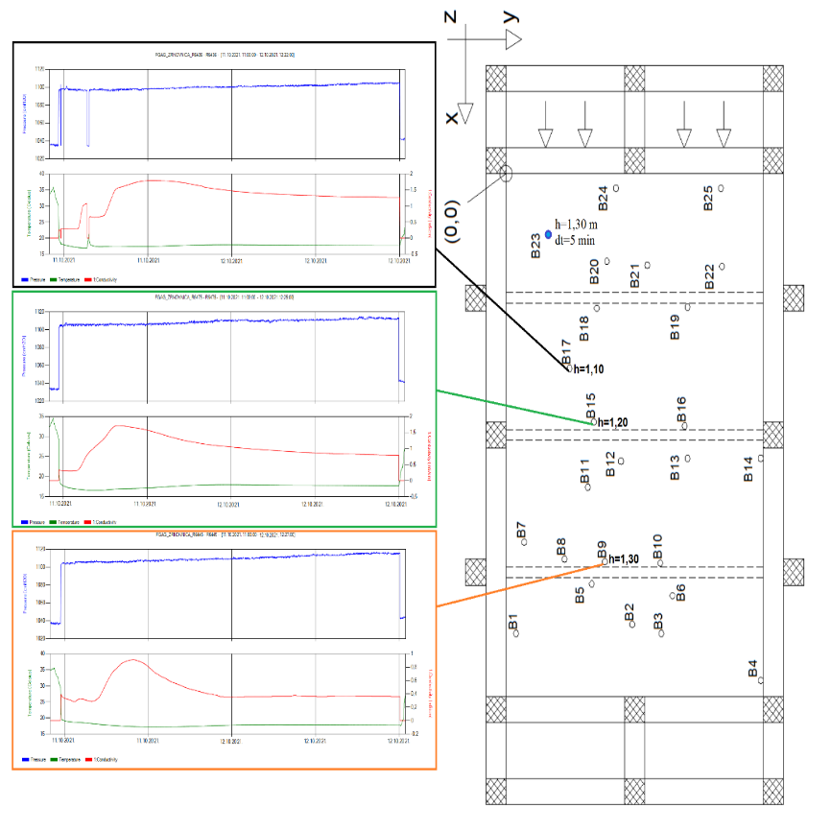
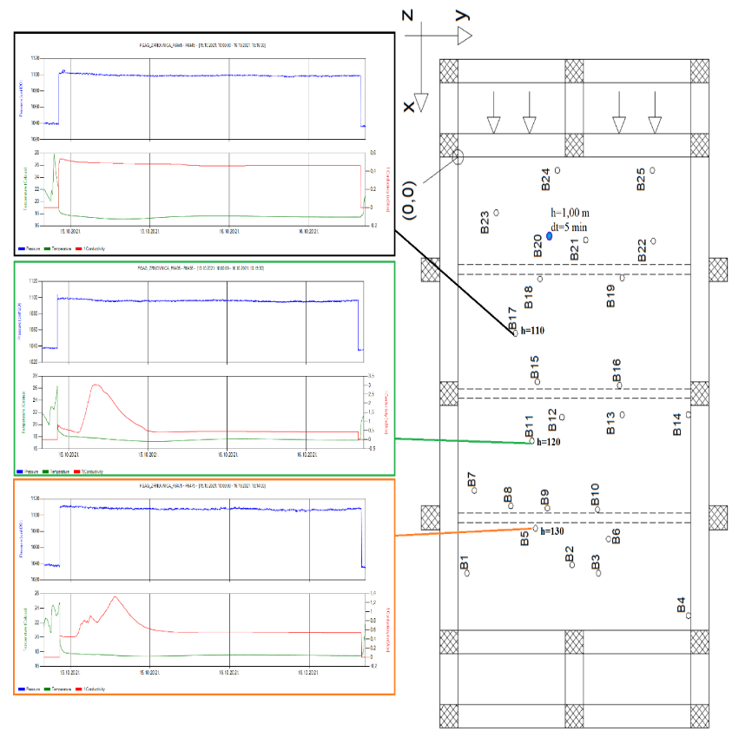
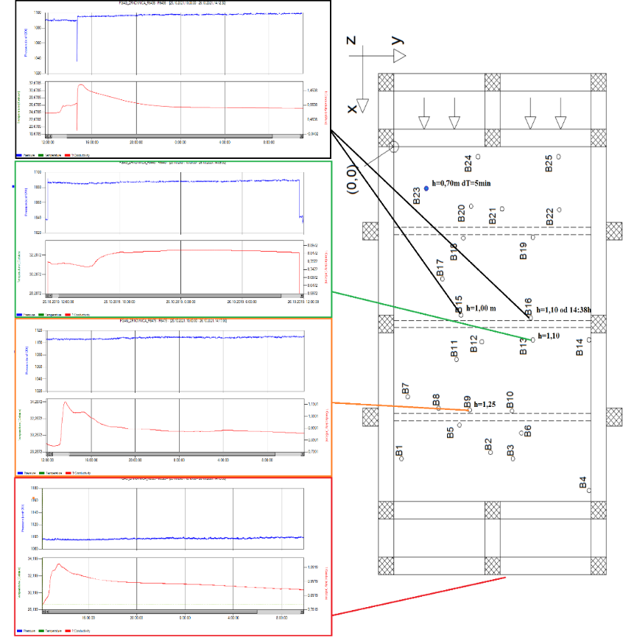
Tracer test results
Figure 8: CTD drivers data from test I1 and schematic view of used boreholes. Red line present conductivity, blue line present pressure and orange is temperature.
Figure 9: CTD drivers data from test I3 and schematic view of used boreholes. Red line present conductivity, blue line present pressure and orange is temperature.
Figure 10: CTD drivers data from test I8 and schematic view of used boreholes. Red line present conductivity, blue line present pressure and orange is temperature.

Slide 16
Second model
Still under construction
Internal dimensions 9,40m x 4,00m x 2,70m
280 piezometers is installed and mesured by electronic equipment
10 diferent layers of soil
Net of diferent pipe profiles are installed to model karst conduits
Precipitation device enables generation of artificial rain from 10 l/h/m² up to 240l/h/m²

Slide 17
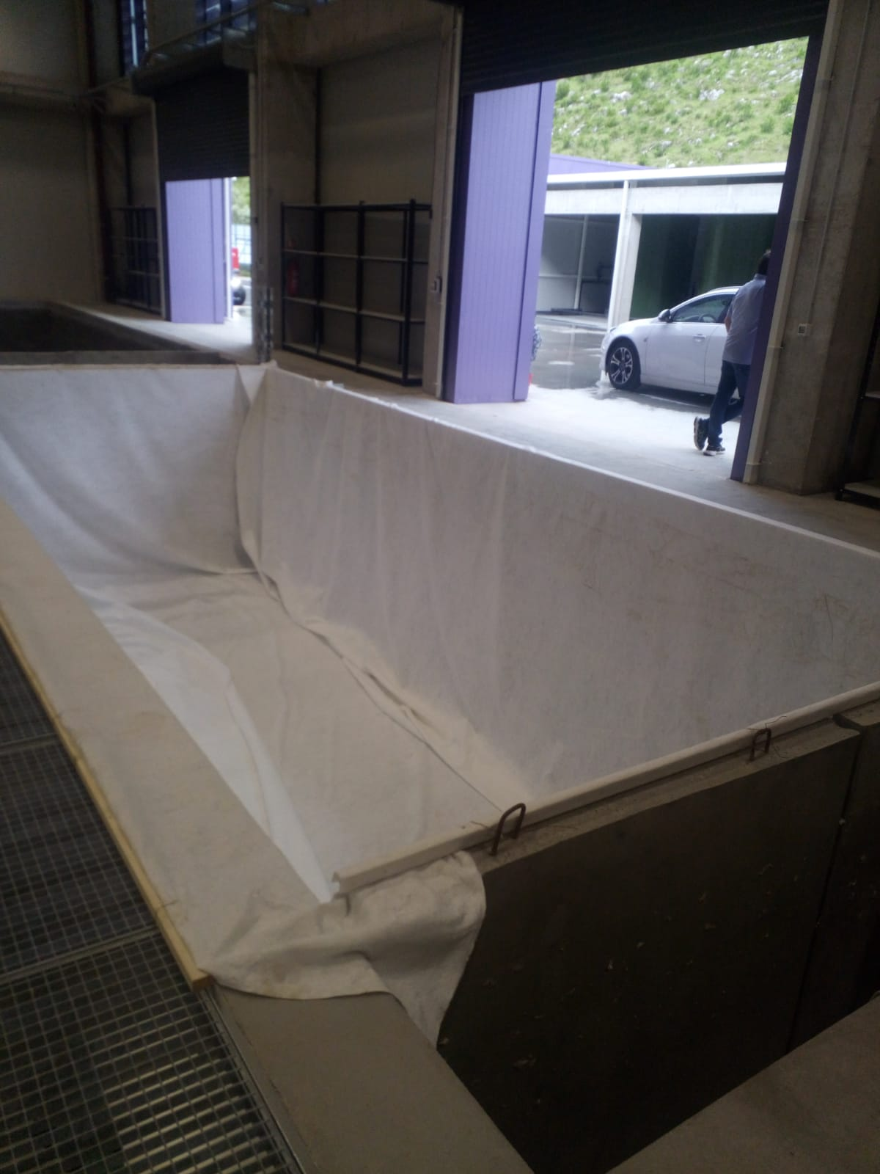
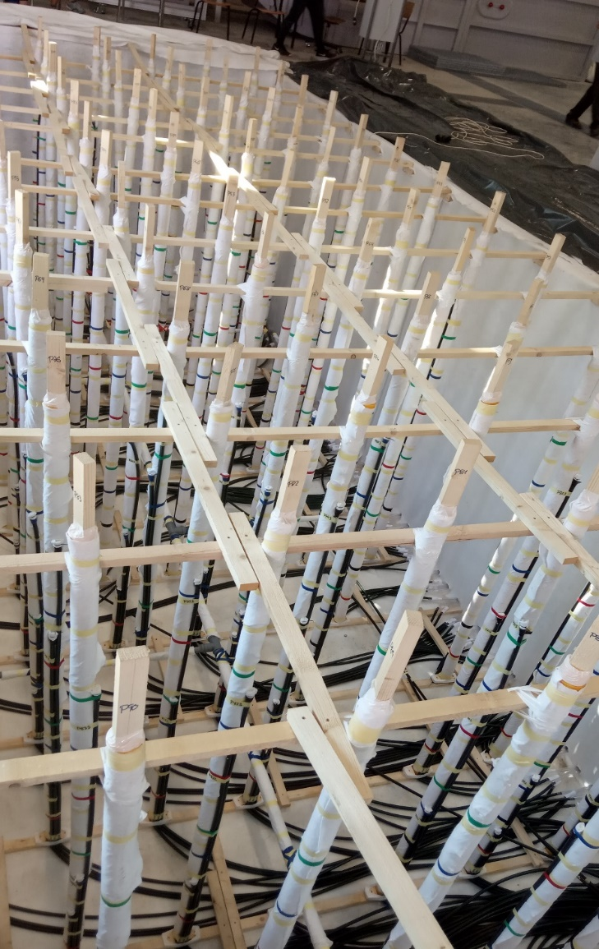
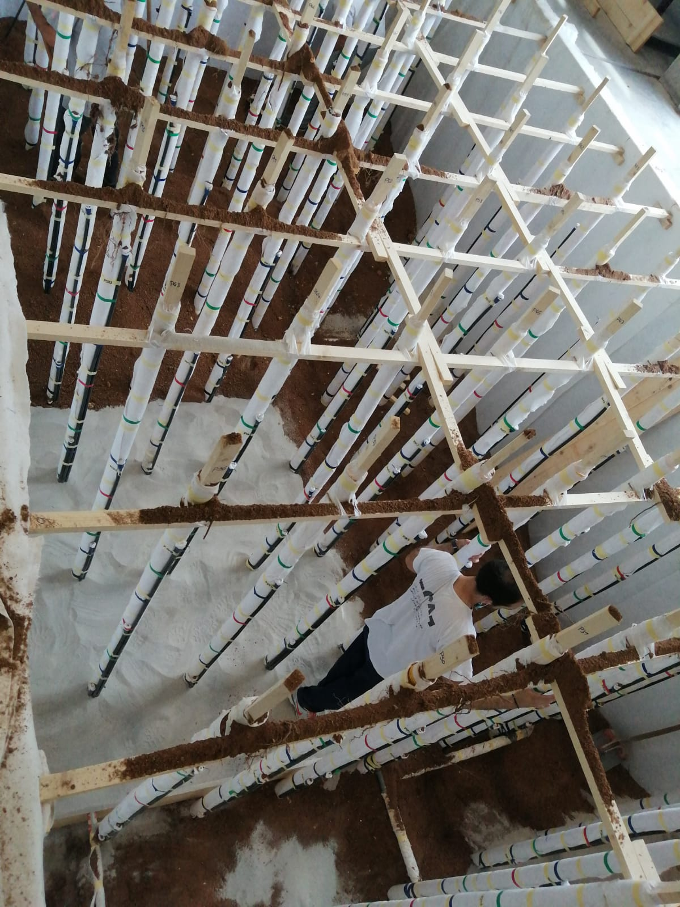
- Basin with geotextile
Installed pipes for measuring piezometric height and PVC pipes for modeling conduits
Installing layers of sand and gravel

Slide 18
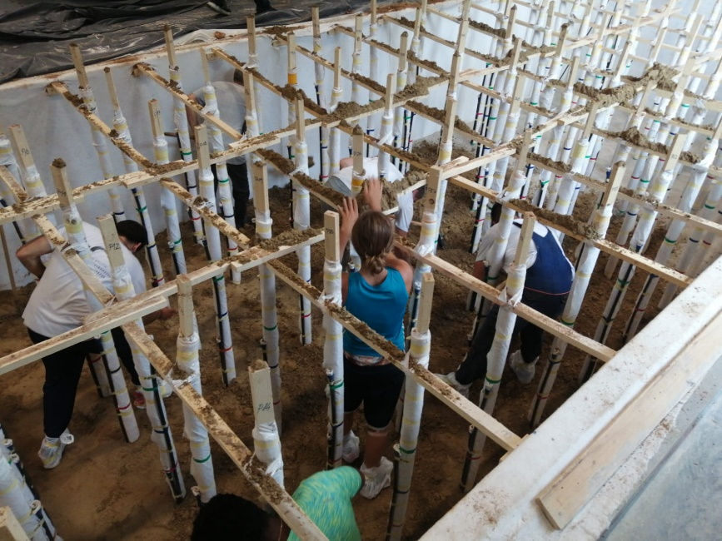
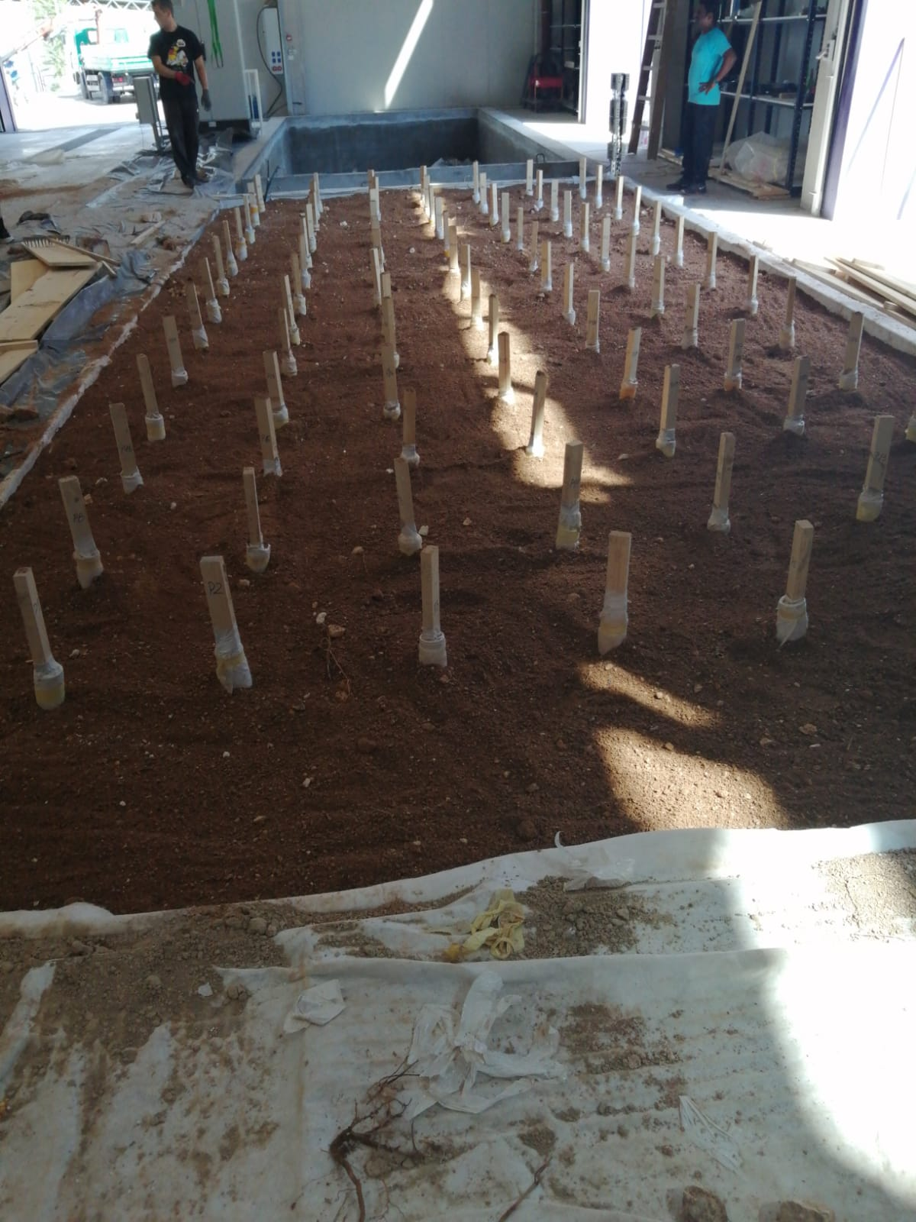
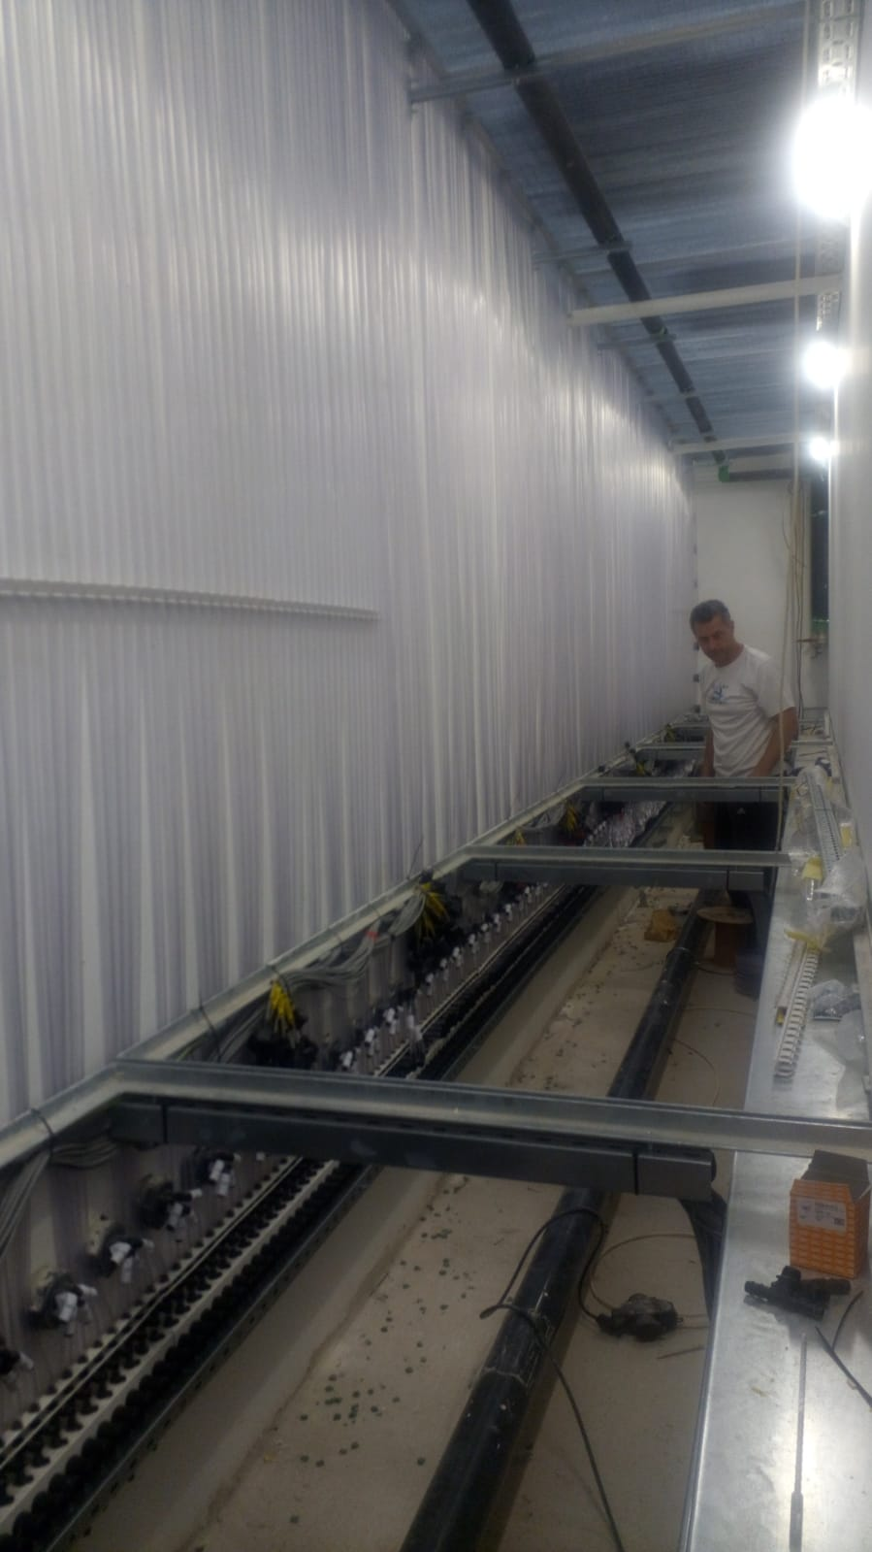
- Layer of clay
- Final layer
- Connecting to the measuring equipment

Slide 19
Summary and Conclusions
First results related to the multiphysics tracer transport modelling are presented
Hybrid discrete continuum flow model presents the main input for transport karst modelling
Flow model is based on CV-IGA and exchange flow parameter
Tracer tests were performed and thay show results within expected limits
Transport model is based on classical advection-dispersion equation and exchange flux depending only on advective transport between matrix and surface flow

Slide 20
Summary and Conclusions (cont.)
Experimental setup in new Hydrolab in Žrnovnica consists of two basins with quartz sand and conduit network system
Future work will show verification and validation of CV-IGA model to flow and transport simulations in karst aquifers
Unique experimental setup will enable definition of new exchange formulations between surface and subsurface domains that is not possible in real aquifers
Final step is application of new model to real sites such as Jadro, Ombla or Neretva karst catchments

Slide 21
Thank you for your attention!

